Slide 1
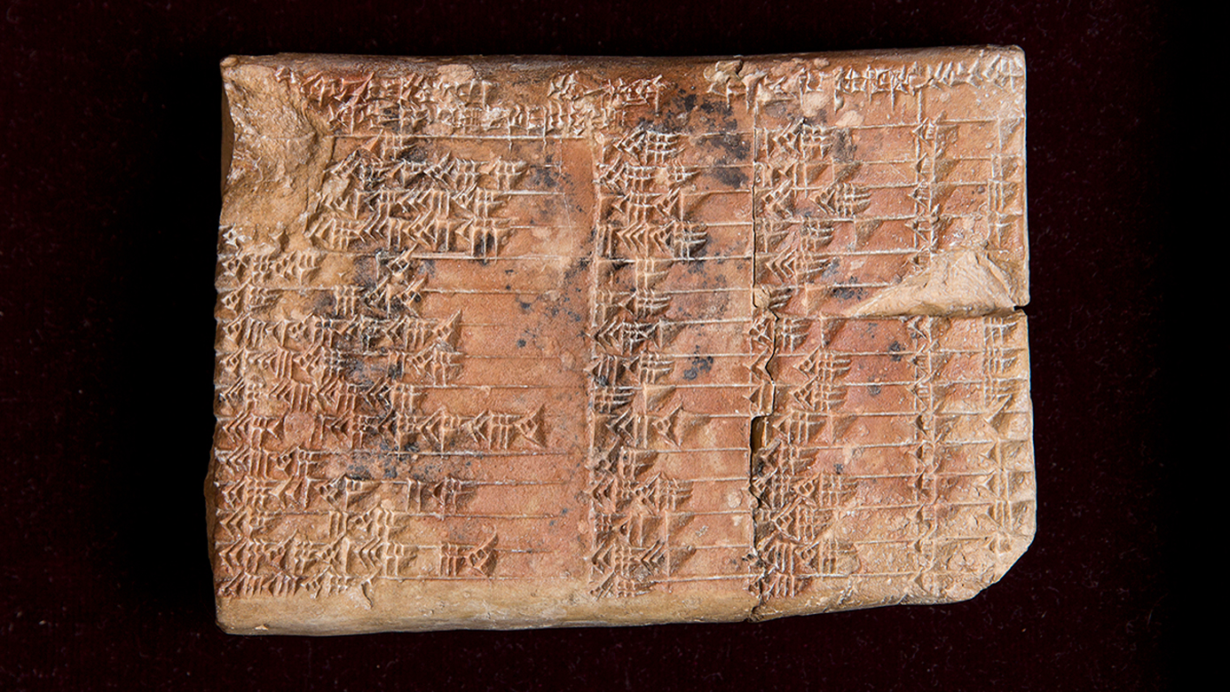
Developing Problem Solving at KS3 (for KS4)
Chris Olley
chris.olley@the-partnership.org.uk

Slide 2
1. Structured Development of Problem Solving Skills
George Polya: How to solve it?
Summary: https://math.berkeley.edu/~gmelvin/polya.pdf
Emre Lakatis (Proofs and Refutations)
Chapter 1: https://math.berkeley.edu/~kpmann/Lakatos.pdf
John Mason: Thinking Mathematically
The Art of Problem Posing: Brown and Walter
NRich: Working Mathematically (KS3 & 4): https://nrich.maths.org/8963

Slide 3
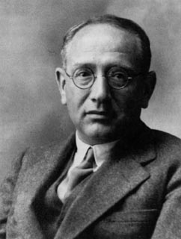
George Polya: : How to solve it?
Polya’s First Principle: Understand the problem
Polya’s Second Principle: Devise a plan
Polya’s Third Principle: Carry out the plan
Polya’s Fourth Principle: Look back

Slide 4
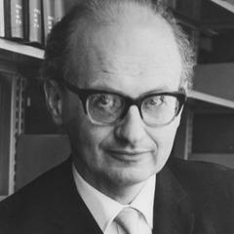
Emre Lakatos: Proofs and Refutations
“The dialogue takes place in an imaginary classroom. The class gets interested in a PROBLEM: is there a relation between the number of vertices V, the number of edges E and the number of faces F of polyhedra-particularly of regular polyhedral …
analogous to the trivial relation between the number of vertices and edges of polygons, namely, that there are as many edges as vertices: V=E?”

Slide 5
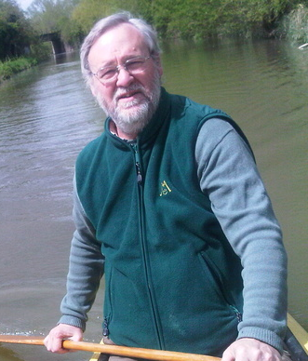
John Mason: Thinking Mathematically
Our approach rests on five important assumptions:
You can think mathematically.
Mathematical thinking can be improved by practice with reflection.
Mathematical thinking is provoked by contradiction, tension and surprise.
Mathematical thinking is supported by an atmosphere of questioning, challenging and reflecting.
Mathematical thinking helps in understanding yourself and the world.

Slide 6
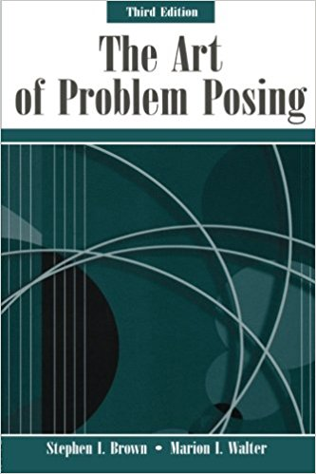
The Art of Problem Posing: Brown and Walter
What problem posing consists of and why it is important.
What strategies exist for engaging in and improving problem posing.
How problem posing relates to problem solving.
What-if-not?

Slide 7
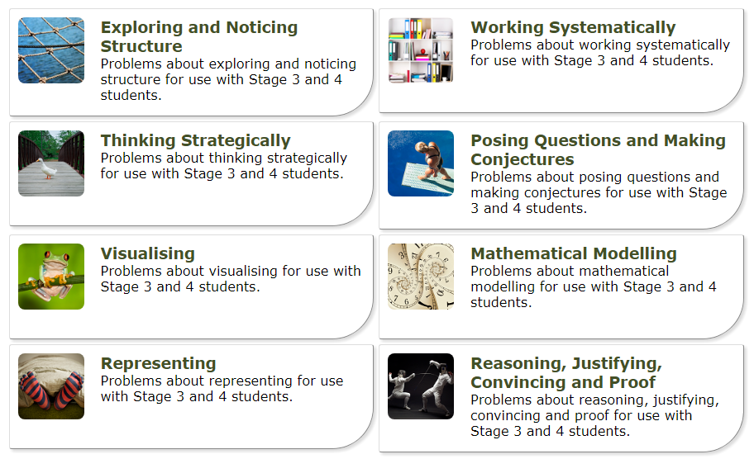
NRich: Working Mathematically

Slide 8
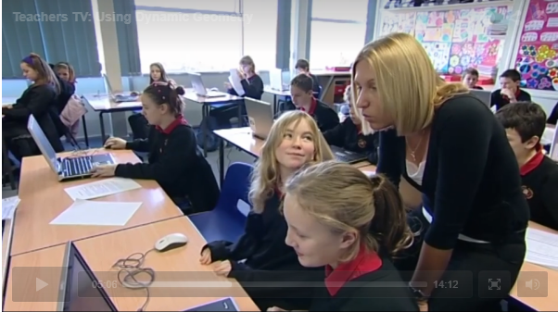
2. A Supportive Classroom Practice
Pedagogic Task (Teacher/Student)
#1: 2:20 #2: 7:35
 | Discourse
Pedagogy | DS+ | DS-
Reserved | Situation/ Composition | Components/ Assembly
Ostensive | Exposition/ Problem | Demonstration/ Drill
Problem Solving

Slide 9
3. Exams are Different
Examination problem solving is a particular form.
It has its own rules.
We need to convert students from problem solvers to exam problem solvers … but that can probably wait until KS4 (?)
http://www.themathszone.com/?p=722

Slide 10
A Problem Solving Lesson
1. Structured Development of Problem Solving Skills.
Which aspect of ‘problem solving’ can be developed using this activity? Choose one to prioritise.
What sort of problem would support developing this activity further?
2. A Supportive Classroom Practice.
Sketch a lesson plan structure that incorporates this activity.
Design questions that will support students’ development of the chosen aspect of problem solving.
3. Place this lesson into your scheme of work with date/time! Soon.

